Slide 1
Application Controller Pattern
CIT 360 GROUP 4 EDGAR ROMERO

Slide 2
CODING TOPIC INTRODUCTION
How / When to Apply it and How to code it
Java has three ways of accomplishing parallel
processing. As with all options, which you
choose depends on the situation. The oldest of
these methodologies is to subclass the base
java.lang.Thread class.
References
Doing more with Java, page 86
Application Controller Pattern:
https://www.youtube.com/watch?v=SXsqCafXBjw
https://www.youtube.com/watch?v=AcOkhFGpiek
https://www.youtube.com/watch?v=dB6DL2R86nw

Slide 3
Application Controller Pattern
Diagram 1 (see next page) is an a UML class diagram for a naive application controller pattern implementation. While method and class names are shown, they are not actually defined parts of the pattern and can be modified to be anything you would like.
The diagram shows that some class in your application will call the handleRequest method of the ApplicationController passing it a command, usually a string, and some optional parameters. The relationship between your application class and the ApplicationController is defined as delegates since once the call has been made your application will do no more independent computation. It has delegated the handling of the situation to the ApplicationController.

Slide 4
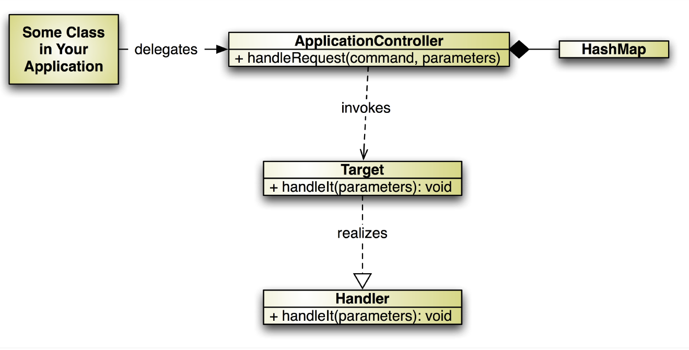
Summary of Application Controller Pattern
Diagram 1: the application controller pattern as a class diagram

Slide 5
Application Controller Pattern
The Target class in the diagram is a placeholder for any number of classes that implement, realize in UML speak, the Handler interface.
This interface is one of your own creation. It is not included in any release of Java. Since all of the targets you create will implement this interface they will each have a unique implementation of a handleIt method.
The HashMap contains a series of keys and values. The keys are command strings and the values are instances of the various target classes. Each of the target classes has, in its handleIt method, all of the code to handle the situation indicated by the command. Each command represents only one situation that needs to be handled.
A design such as this is highly modular and makes the addition of new behavior and the support of existing behavior much easier than many other designs. This design also solves the if-else problem described earlier.

Slide 6
Application Controller Pattern
Since a user logging in is a commonly understood problem let’s use it as an example. Diagram 2 is a UML sequence diagram illustrating using the Application controller pattern to handle this situation. The diagram assumes that the application is already running but the user has not logged in.
You can see the flow of the method calls in this diagram. It shows that the Handler instance specific to the login command is found in the HashMap and the Hander’s handleIt method is called. If you were creating an online bank you may have a Handler instance for “transfer funds,” another for “makeDeposit,” and many others.
If your application was a calculator you could have a Handler instance for “add” or “subtract” or some other function. Regardless of how many Handler instances your application has and what situations they are intended to handle the code within the handleIt method of each of your handlers will be unique to the situation it is to handle. These handlers should be independent of each other and do all of the computing as well as all interaction with the user interface, databases, web services, or any other resource that is needed to resolve the request.

Slide 7
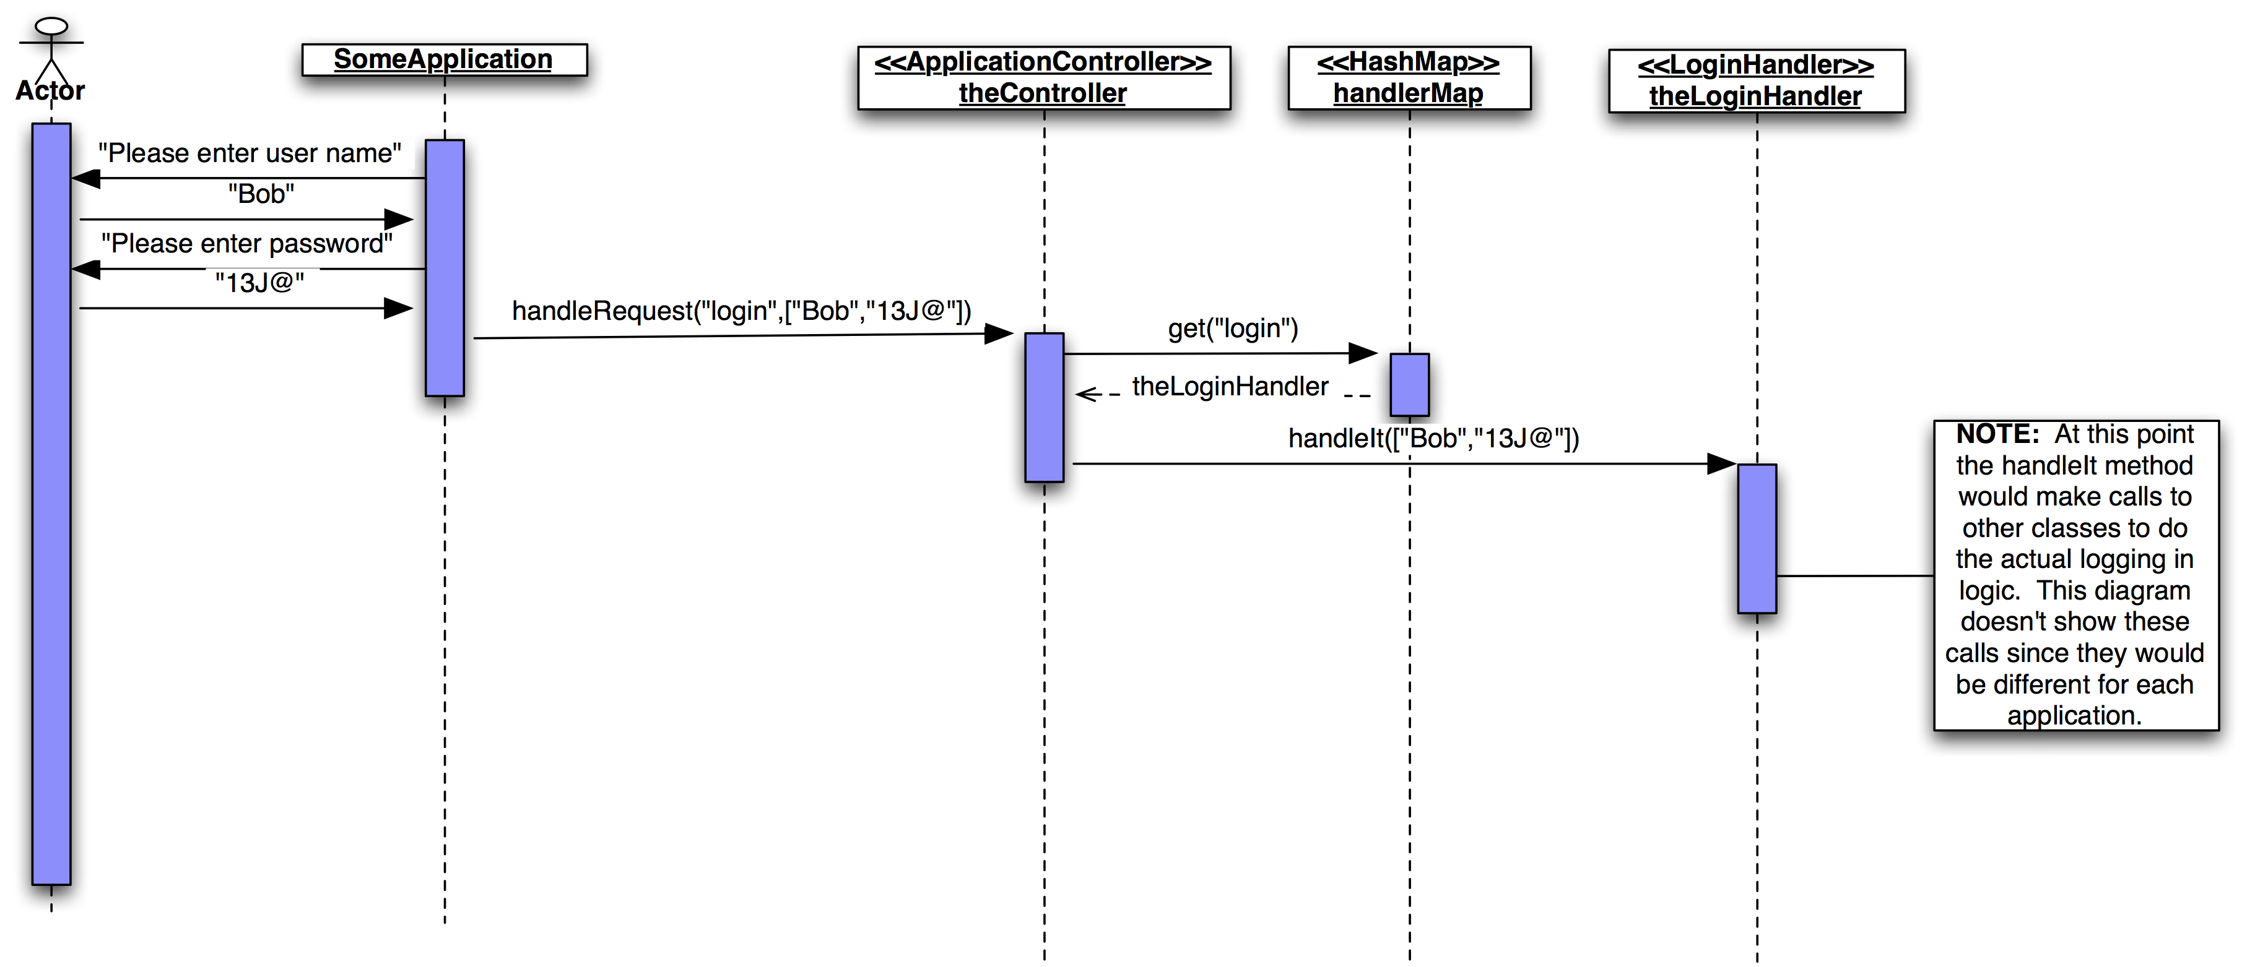
Summary of Application Controller Pattern
Diagram 1: the application controller pattern as a class diagram

Slide 8
Application Controller Pattern
The class you’ll need to create is found in the ApplicationController.java code sample.
There isn’t much code there either. One method, mapCommand is used to associate command Strings with instances of classes that implement the Handler interface.
package com.doing.more.java.example.appcontrol;
import java.util.HashMap;
public class ApplicationController {
private HashMap<String,Handler> handlerMap = new HashMap();
public void handleRequest(String command, HashMap<String,Object> data){
Handler aCommandHandler = handlerMap.get(command);
if (aCommandHandler != null){
aCommandHandler.handleIt(data);
} }
public void mapCommand(String aCommand, Handler acHandler){
handlerMap.put(aCommand,acHandler);
} }

